Slide 1
Structure of communications
Transmission Media
Inglés
Prepared by: Vietto Herrera Santiago - 1802890
Professor: Graciela Giraudo

Slide 2
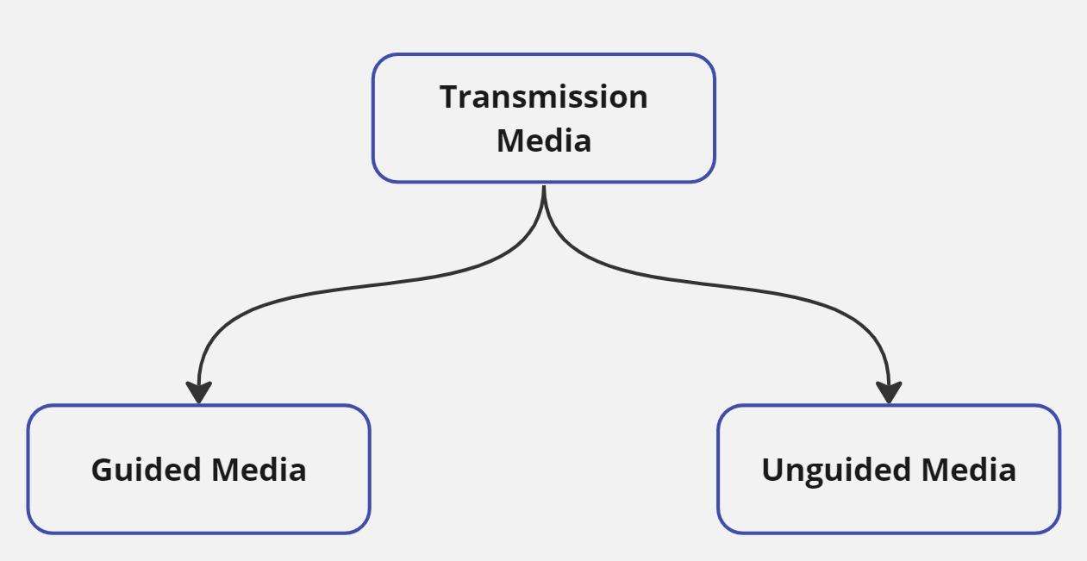
Transmission Media
We have two big groups:

Slide 3
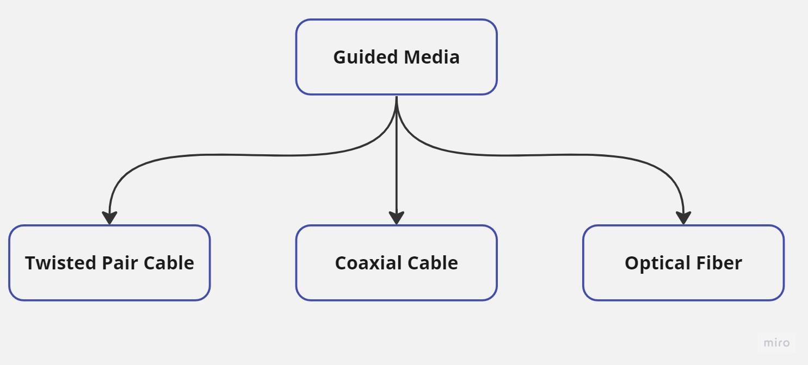
Guided Media

Slide 4
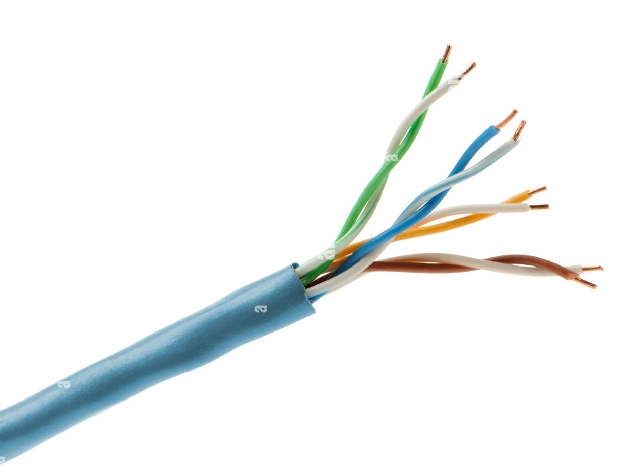
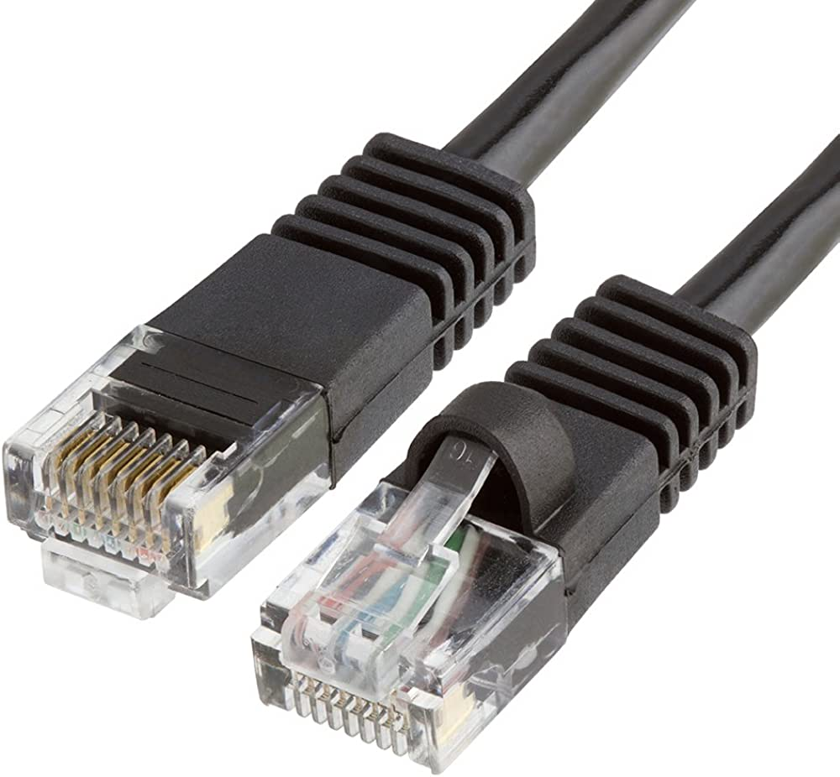
Guided Media
Twisted Pair Cable - (UTP - Unshielded Twisted Pair)
Cost: Low
Electromagnetic Interface: High
Security: Low
Bandwidth: Low

Slide 5
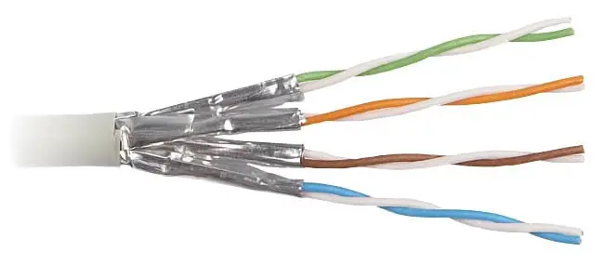
Guided Media
Twisted Pair Cable - (STP - Shielded Twisted Pair):
Cost: Moderate
Electromagnetic Interface: Moderate
Security: Low
Bandwidth: Low

Slide 6
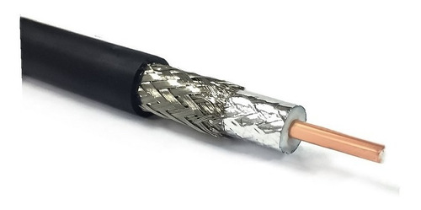
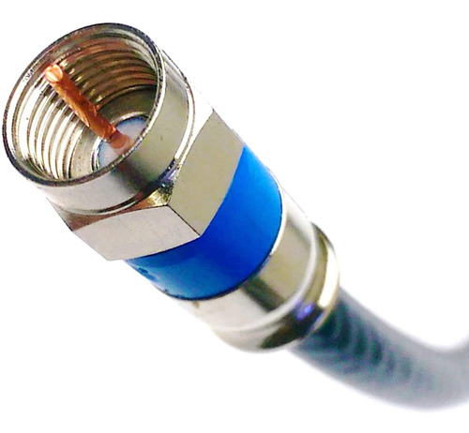
Guided Media
Coaxial Cable
Cost: Moderate
Electromagnetic Interface: Moderate
Security: Low
Bandwidth: Moderate

Slide 7
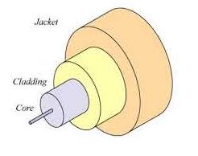
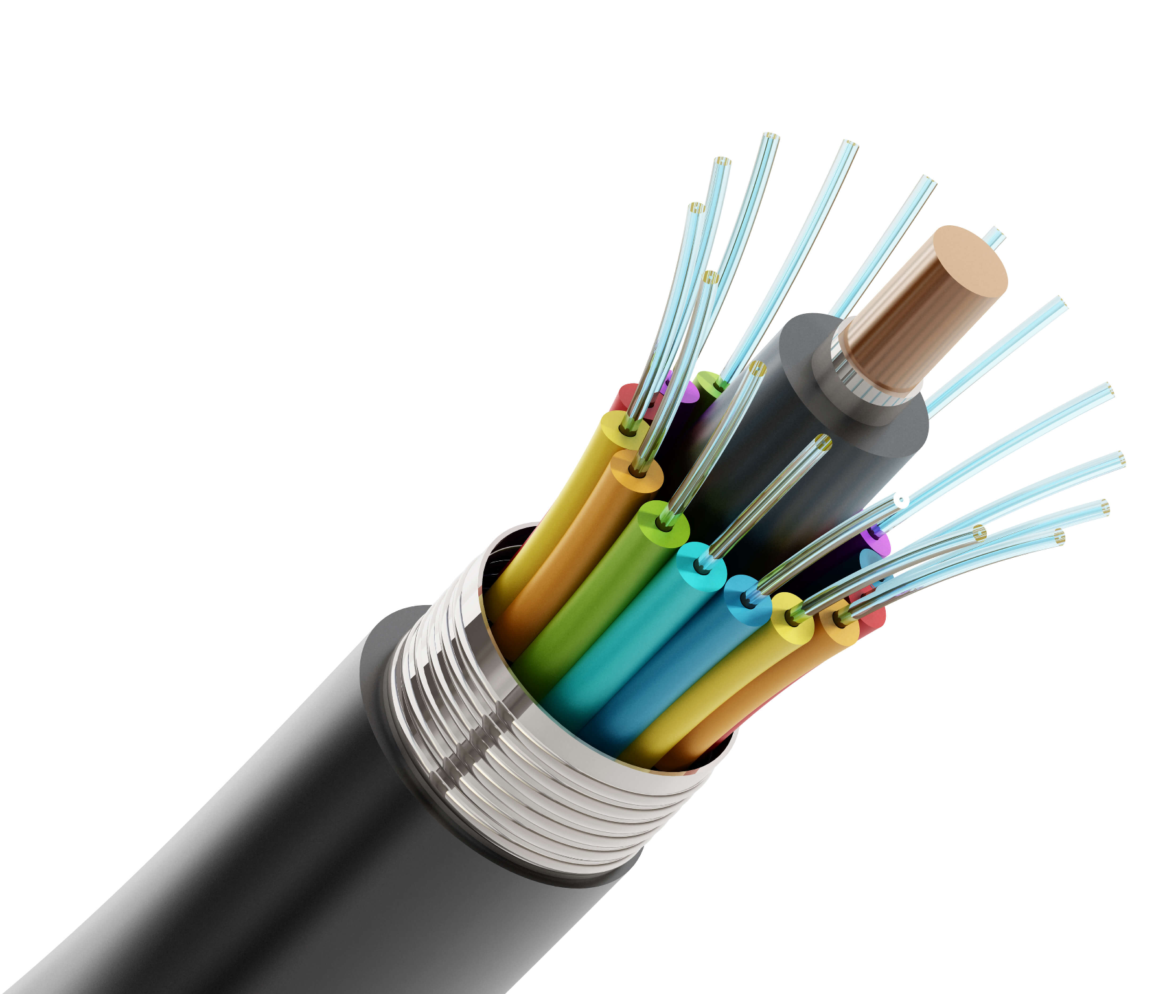
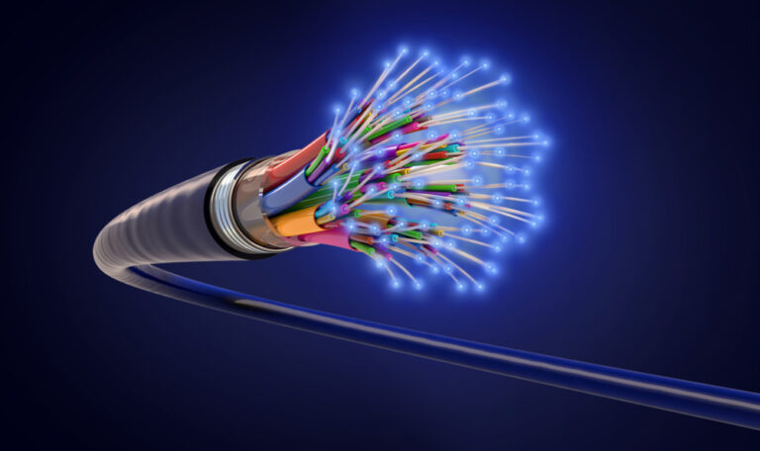
Guided Media
Optical Fiber
Cost: High
Electromagnetic Interface: Low
Security: High
Bandwidth: Very High

Slide 8
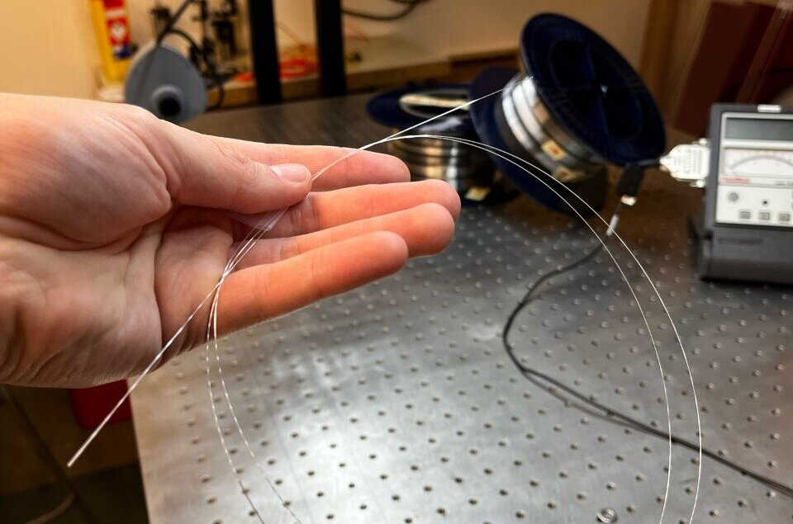
Guided Media
Optical Fiber

Slide 9
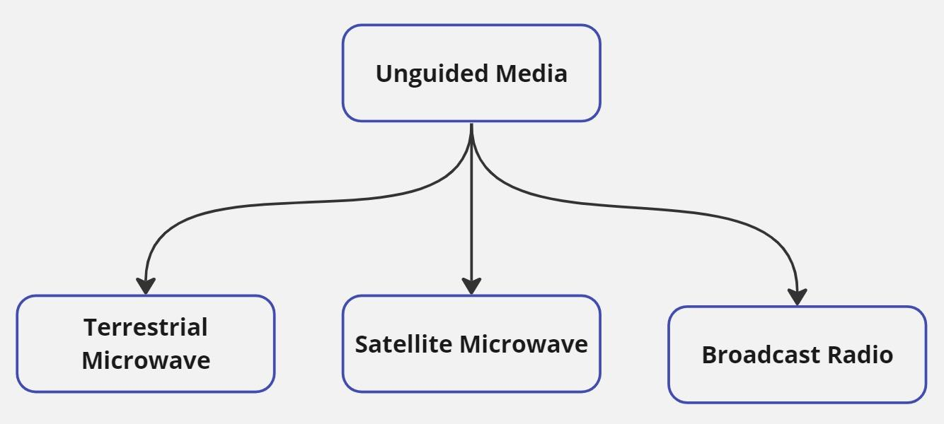
Unguided Media

Slide 10
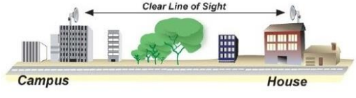
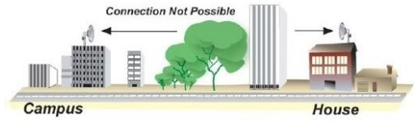
Unguided Media
Terrestrial Microwave
Cost: High
Electromagnetic Interface: High
Security: Moderate
Bandwidth: Moderate

Slide 11
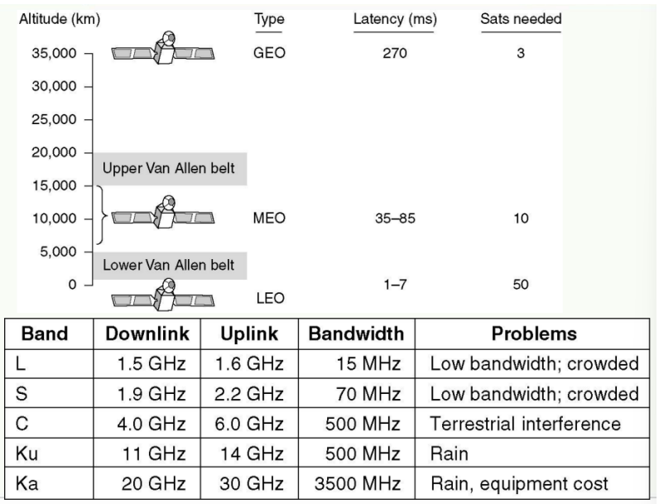
Unguided Media
Satellite Microwave
Cost: Very High
Electromagnetic Interface: High
Security: Moderate - High
Bandwidth: Moderate - High

Slide 12
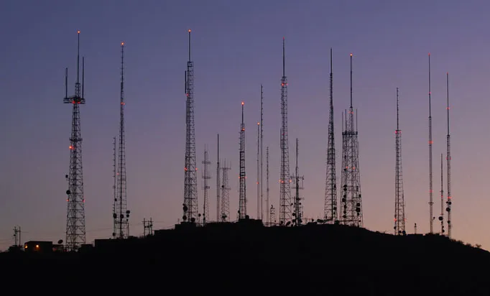
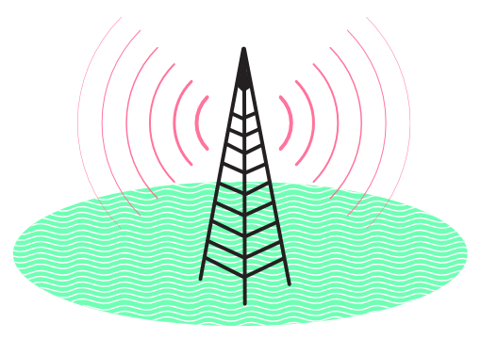
Unguided Media
Broadcast Radio
Cost: Moderate
Electromagnetic Interface: High
Security: Low
Bandwidth: Moderate

